Slide 1
CI WITH Jenkins AND github (webhook)

Slide 2
Summary
What is DevOps?
Traditional Development vs DevOps.
Continuous Integration/Continuous Deployment.
CI With Jenkins AND GitHub (webhook).
Jenkins
GitHub
What is a Webhook?

Slide 3
TOOLS
Jenkins: https://jenkins.io/download/
Java: https://www.java.com/es/download/
Git: https://git-scm.com/downloads
Ngrok: https://ngrok.com/download
Homebrew (only for Mac users):
-In your terminal, install Homebrew using the command found at:
https://brew.sh/index_es
-In your terminal, install Java using:
brew cask install java
Notes:
Repo with tools: https://github.com/DanielaZacarias/DevOps-workshop-Jenkins

Slide 4
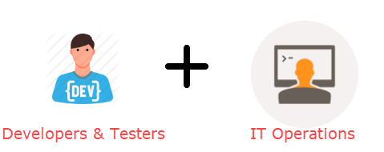
What is DevOps?

Slide 5
Before DevOps...

Slide 6

DevOps
“DevOps is the combination of cultural philosophies, practices, and tools that increases an organization’s ability to deliver applications and services at high velocity.”
-AWS
https://aws.amazon.com/devops/what-is-devops/

Slide 7
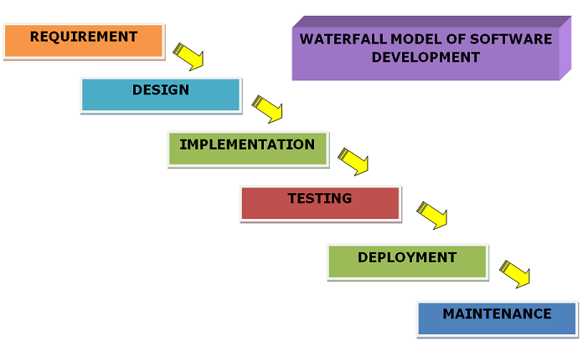
Traditional Development

Slide 8
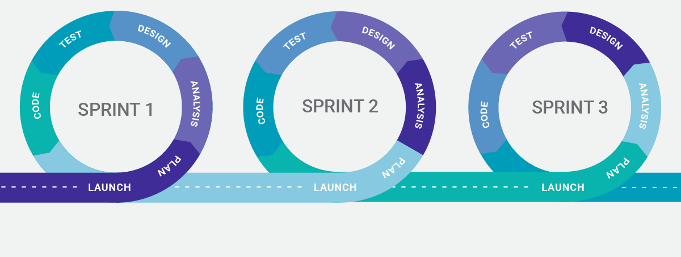
Agile Model

Slide 9
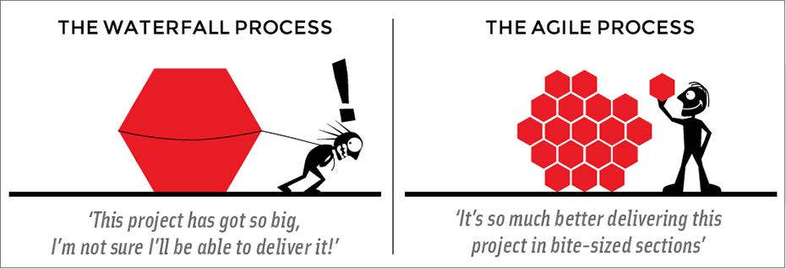
Agile vs Waterfall

Slide 10
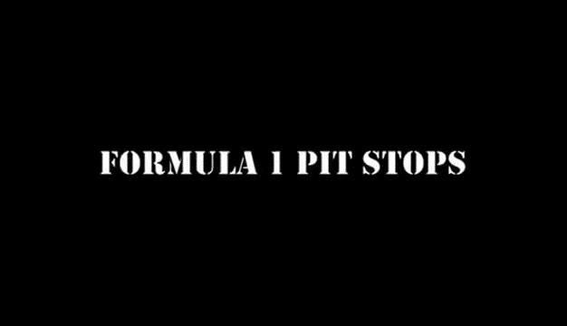
Traditional Development (Waterfall)

Slide 11

DevOps + Agile

Slide 12
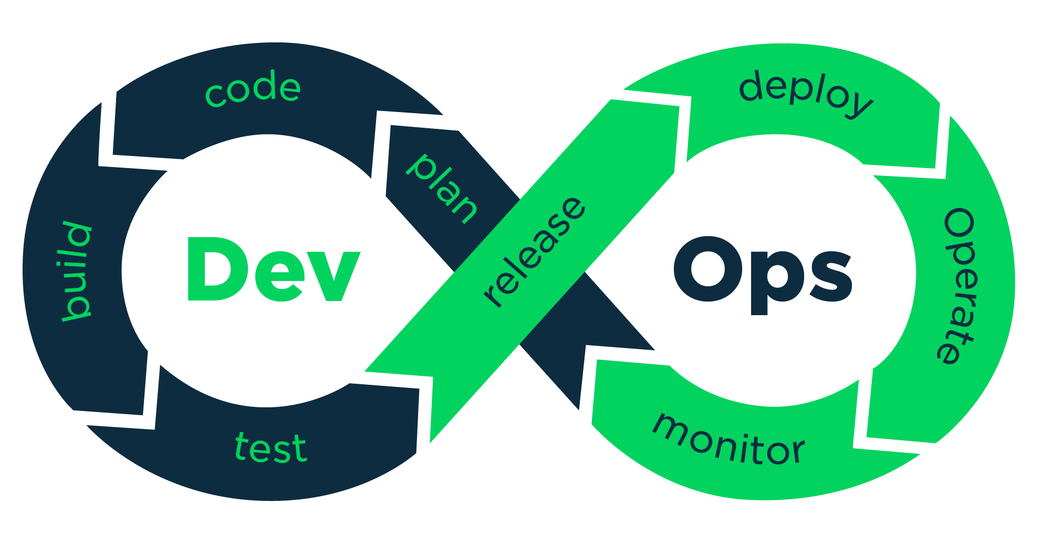
DevOps + Agile

Slide 13
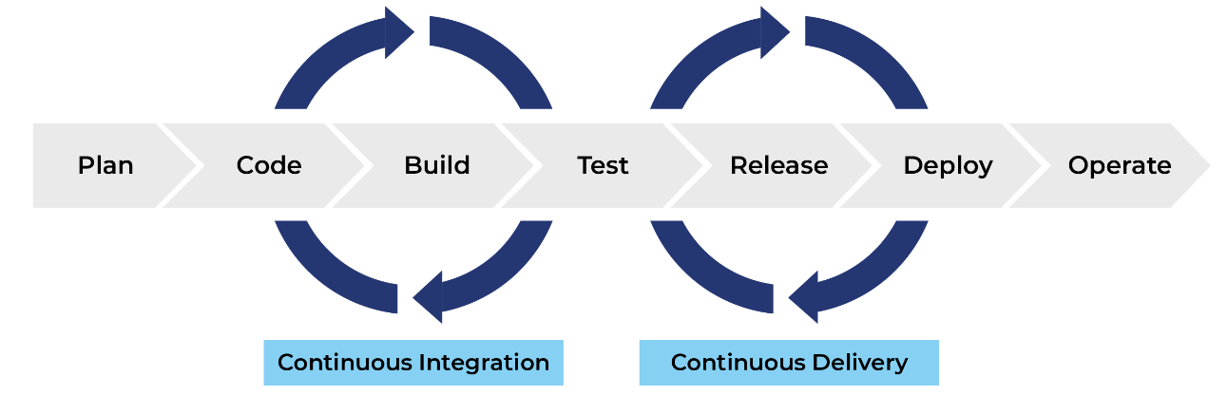
Continuous Integration
&
Continuous Delivery

Slide 14

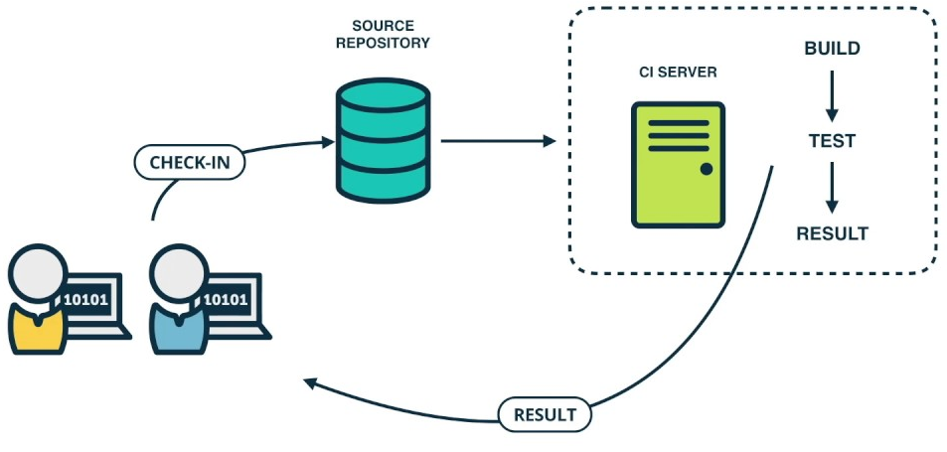
Continuous Integration
Continuous integration is the practice of frequently merging code changes.
Benefits:
Fast feedback
Fast detection of issues
Avoid difficult integration
The problem:
Is everything correctly compiled?
Who checks the code after each merge?
AUTOMATION!

Slide 15
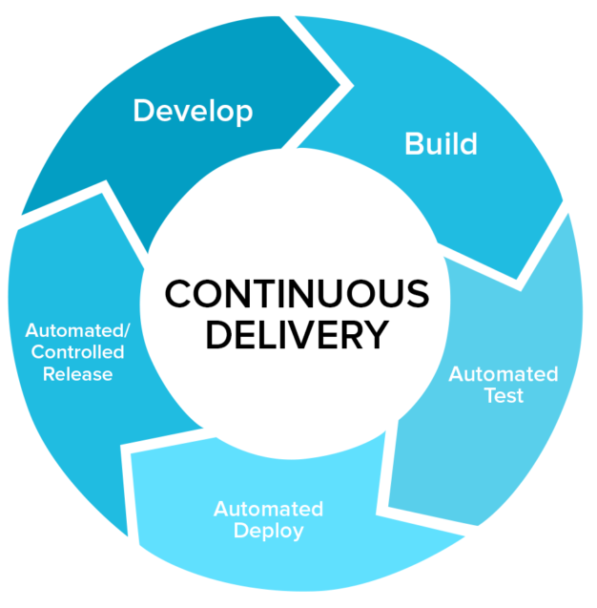
Continuous Delivery
Continuous Delivery is the ability to get changes of all types—including new features, configuration changes, bug fixes and experiments—into production, or into the hands of users, safely and quickly in a sustainable way.
Benefits:
Low risk releases
Faster time to market
Higher quality
Lower costs.
Happier teams.

Slide 16
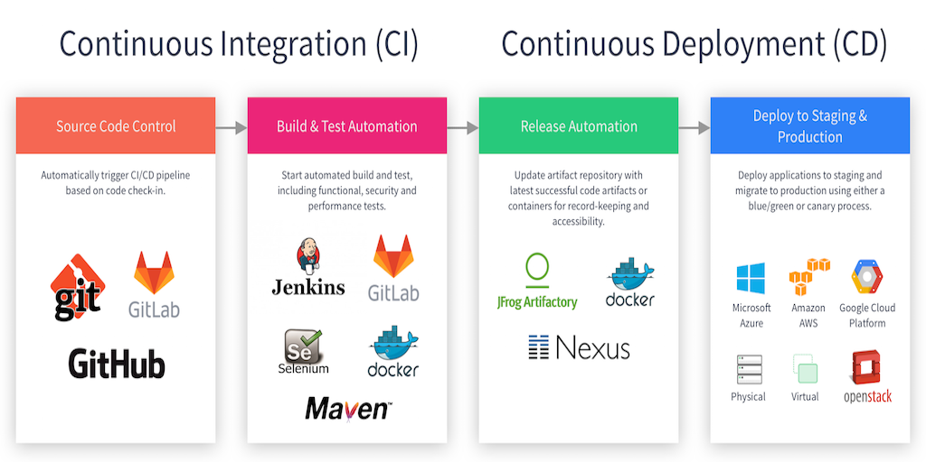

Slide 17
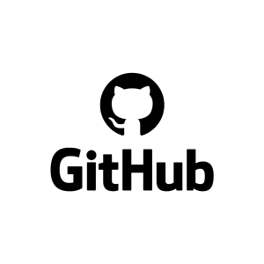
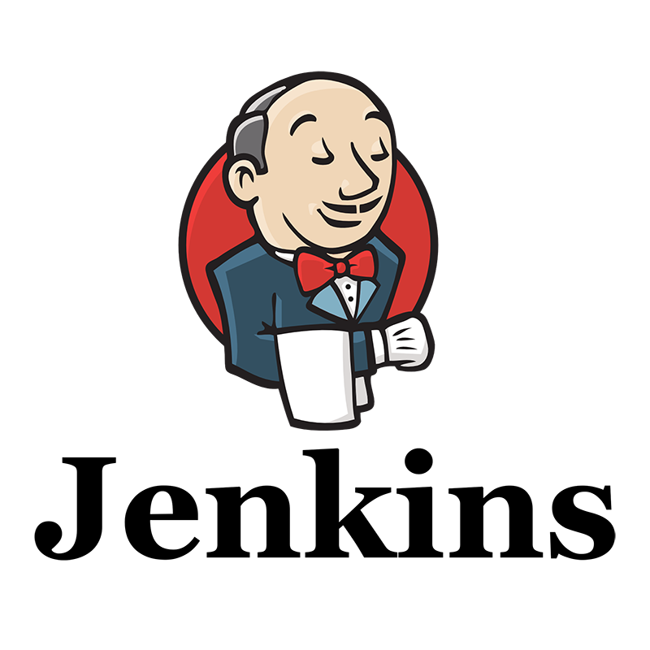
WORKSHOP: CI WITH Jenkins AND github (webhook)

Slide 18
Workshop Objectives
To create a Webhook between CI tool Jenkins and version control tool GitHub, using Ngrok as a tunnel for our local web server.
To create a Jenkins pipeline
Requirements:
Creation of GitHub account.
Installation and configuration of Jenkins in local machine.
Installation of Ngrok in local machine.

Slide 19
Jenkins
Jenkins is a CI/CD tool that automatically prepares/compiles the code and runs automated tests.
This is called a build, and if something goes wrong, it fails.
-> Immediate feedback.

Slide 20
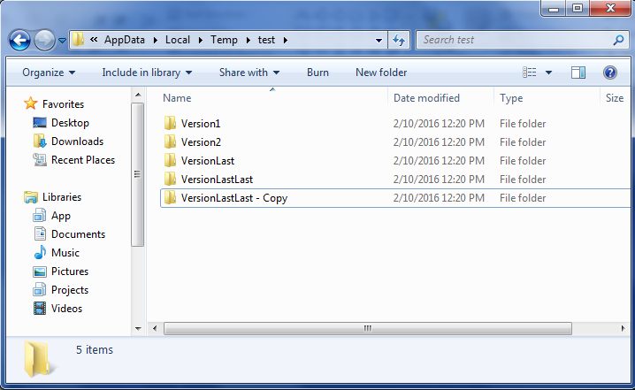
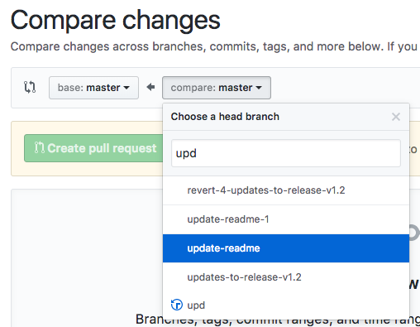

Jenkins + GitHub
GitHub is a web-based version control tool in which you can host your projects.
Jenkins needs to be linked to a repository in order to access the code of your project.

Slide 21
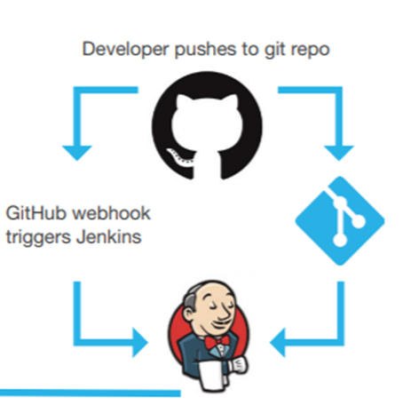
Webhooks
Webhooks are "user-defined HTTP callbacks“.
Triggered by an event such as pushing code to a repository, or a comment being posted to a blog.
The source site makes an HTTP request to the URL configured for the webhook.
These are used to cause events on one site to invoke behavior on another.

Slide 23
Getting started…
For mac users:
-In your terminal, install Homebrew using the command found at:
https://brew.sh/index_es
-In your terminal, install Java using: brew cask install java
Step. 1. Install Jenkins in local machine from: https://jenkins.io/download/
Step. 2. Copy and paste initialAdmin password
Step. 3. Install suggested plugins
Step. 4. Setup admin information
Step. 5. Create GitHub account: https://github.com
Download Git from: https://git-scm.com/downloads
Create GitHub account at: https://github.com/

Slide 24
Step. 6. Create new project in GitHub
Step 7. Back in Jenkins, create a New Freestyle Project called First job
Step 8. In the “General” section, select the “GitHub project” option and paste the URL of your GitHub repository. https://github.com/[mygithubaccount]/[myrepo]
Step 9. In the “Source Code Management” section, select the “Git” option and paste the URL of your GitHub repository.https://github.com/[mygithubaccount]/[myrepo].git
Step 10. Within the same section, in the “Repository browser” option, select “githubweb”, and paste the URL of your GitHub repository.https://github.com/[mygithubaccount]/[myrepo]

Slide 25
Step 11. In the “Build Triggers” section, select the “GitHub hook trigger for GITScm polling” option.
Step 12. Save your project.
Step 13. Download Ngrok in your localmachine from: https://ngrok.com/download
For mac users use: brew cask install ngrok
Step 14. Run the following command: ngrok http 8080
Step 15. Copy the http URL that appeared next to “Forwarding” and try to access it from the internet to see if it works, it should redirect you to Jenkins.
Step 16. If everything works correctly, go to your Github repository and go to the “Settings” tab.

Slide 26
Step 17. Go to the “Webhooks” tab and select the option “Add Webhook”
Step 18. In the “Payload URL” space, paste the URL generated by ngrok like this: http://[ngrok_url]/github-webhook/
Step 19. Leave the default options and click “Add webhook”
Step 20. Back in your “Code” tab, make a commit in your repository. This commit should automatically trigger a Build in your Jenkins console.

Slide 27
Create your first pipeline!
Step 1. Go to Jenkins → Manage jenkins → Manage plugins → Click on Available → Install Build pipeline plugin and Parameterized Trigger Plugin
Step 2. Create two more Freestyle jobs called Second job and Third job
Step 3. Go to First job → click on configure → Mark box "This project is parameterized" → Create a string parameter NAME with your name as default value
Step 4. Click on Advanced... → Use custom workspace → Directory: C:\Program Files (x86)\Jenkins\jobs\{new directory of your new workspace}
Don't forget to create this directory in the chosen path.
Step 5. In Build select Execute Windows Batch Command → write these lines:
echo echo OFF >> jenkins_script.bat echo echo Participant: %NAME% >> jenkins_script.bat ./jenkins_script.bat

Slide 28
Step 6. In Post-build Actions → Select Trigger parameterized build on other projects → Projects to build: Second job → Add parameters: Current build parameters → Click on Save.
Step 7. Go to Second job → click on configure Mark box "This project is parameterized" → Create a string parameter NAME. → Create another string parameter called DATE with the date as default value.
Step 8. Click on Advanced... → Use custom workspace → Directory: C:\Program Files (x86)\Jenkins\jobs\{new directory for your new workspace}
Step 9. In Build select Execute Windows Batch Command → write these lines: echo echo Date: %DATE% >> jenkins_script.bat ./jenkins_script.bat

Slide 29
Step 10. In Post-build Actions → Select Trigger parameterized build on other projects → Projects to build: Third job → Add parameters: Current build parameters → Click on Save.
Step 11. Go to Third job → click on configure Mark box "This project is parameterized" → Create a string parameter NAME and other one called DATE → Create another string parameter called SEMESTER with your semester as default value.
Step 12. Click on Advanced... → Use custom workspace → Directory: C:\Program Files (x86)\Jenkins\jobs\{new directory of your new workspace}
Step 13. In Build select Execute Windows Batch Command → write these lines: echo echo Semester: %SEMESTER% >> jenkins_script.bat echo pause >> jenkins_script.bat ./jenkins_script.bat
Click on Save.

Slide 30
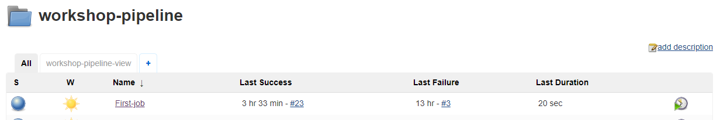
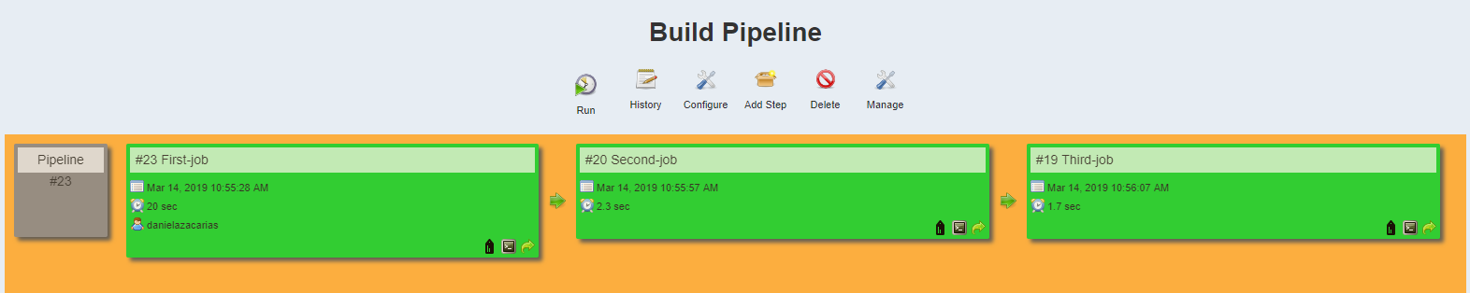
Step 14. Click on the + sign next to All inside your folder. This will create a New view.
Step 15. Write a view name and select a build pipeline view. Click Ok.
Step 16. In pipeline flow → layout → select initial job: First-job. Click OK.
Click on Run in the build-pipeline-view. Done! You have a pipeline in Jenkins!

Slide 31
QUESTIONS TIME

